Slide 1

Learning cross-lingual mappings of word embeddings
Pratik Jawanpuria

Slide 2


Cross-lingual mapping problem: Introduction
$$X$$
$$Z$$
king
पानी
eat
राजा
sun
खा
water
रवि
.
.
.
.
.
.

Slide 3

Cross-lingual mapping problem: Introduction
$$X$$
$$Z$$
king
पानी
eat
राजा
sun
खा
water
रवि
.
.
.
.
.
.
Cross lingual mapping is unknown

Slide 4
Cross-lingual mapping problem: Applications
$$X$$
$$Z$$
Query translation
king
पानी
Machine translation
eat
राजा
Building bilingual
dictionaries
sun
खा
Sentiment analysis
water
रवि
.
.
.
.
.
.
Sharing annotated
data across
languages in various
NLP applications
Text classification
Cross lingual mapping is unknown

Slide 5
Cross-lingual mapping problem: Goal
$$X$$
$$Z$$
king
पानी
eat
राजा
sun
खा
water
रवि
.
.
.
.
.
.
Goal: Learn a mapping between the sets

Slide 6
Cross-lingual mapping problem: Goal
$$X$$
$$Z$$
king
पानी
eat
राजा
sun
खा
water
रवि
.
.
.
.
.
.
function
Goal: Learn a mapping between the sets

Slide 7
Mapping cross-lingual word embeddings
$$X$$
$$Z$$
king
पानी
eat
राजा
sun
खा
water
रवि
.
.
.
.
.
.
Both English and Hindi words are represented via vectors known as word embeddings

Slide 8
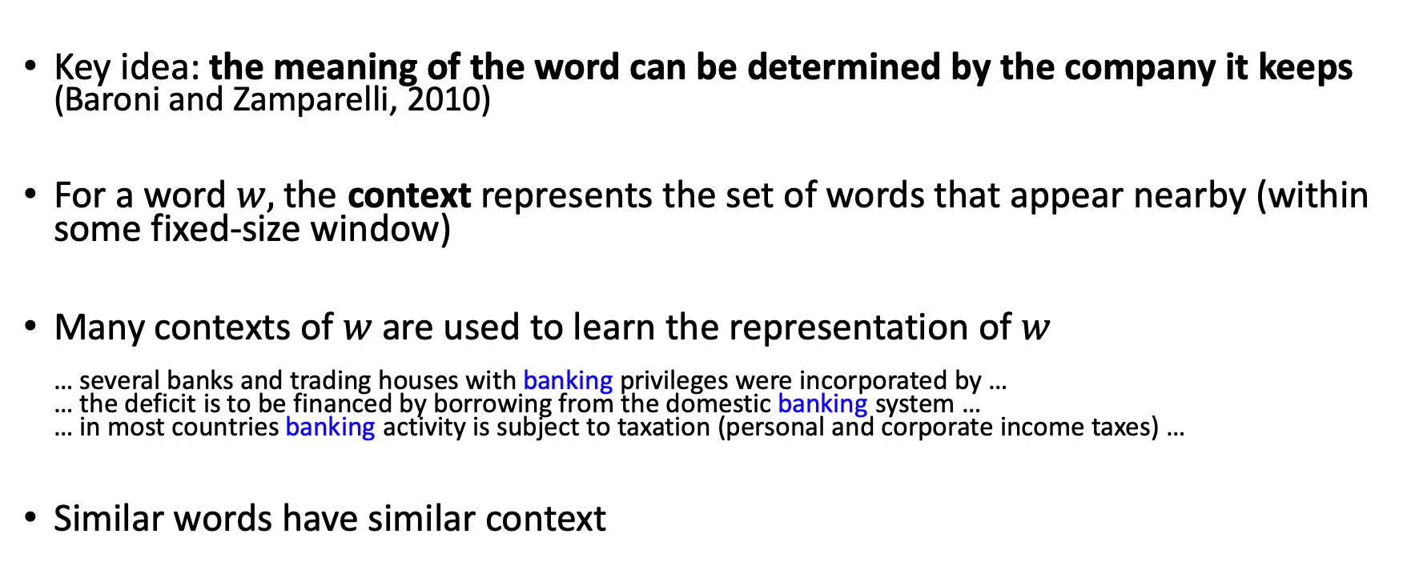
Word embeddings: Representing words by their context
Key idea: the meaning of the word can be determined by the company it keeps (Baroni and Zamparelli, 2010)
For a word $w,$ the context represents the set of words that appear nearby (within some fixed-size window)
Many contexts of $w$ are used to learn the representation of $w$ … several banks and trading houses with banking privileges were incorporated by … … the deficit is to be financed by borrowing from the domestic banking system … … in most countries banking activity is subject to taxation (personal and corporate income taxes) …
Similar words have similar context

Slide 9
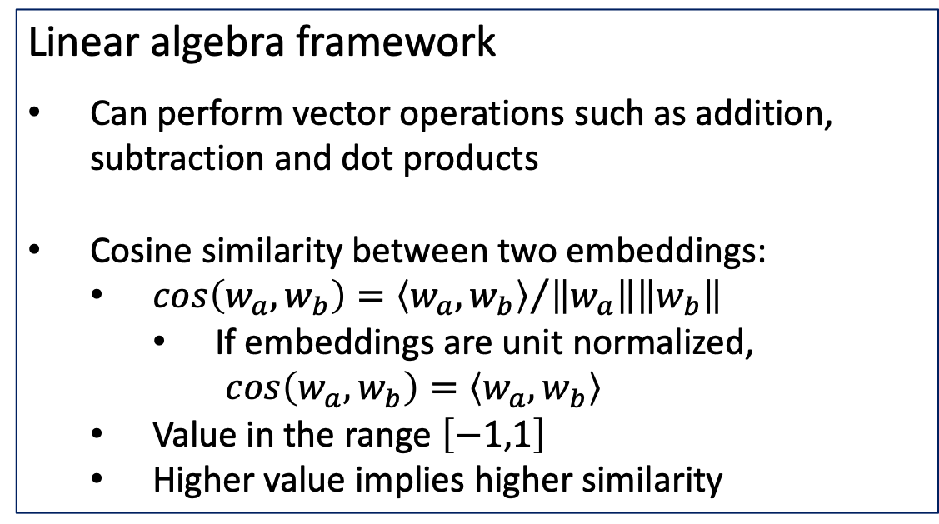
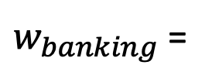
Word embeddings: Representing words as (dense) vectors
0.1896
-0.1002
-1.9648
0.1246
1.5183
1.7752
-0.4021
0.6291
0.1940
Linear algebra framework
Can perform vector operations such as addition, subtraction and dot products
Cosine similarity between two embeddings:
$cos\left(w_{a},w_{b}\right)={\left\langle w_{a},w_{b}\right\rangle }/{\left\|w_{a}\right\|\left\|w_{b}\right\|}$
If embeddings are unit normalized, $cos\left(w_{a},w_{b}\right)=\left\langle w_{a},w_{b}\right\rangle$
Value in the range $\left[−1,1\right]$
Higher value implies higher similarity
$w_{banking}$ =
Popular embeddings:
Word2Vec (Mikolov et al., 2013a)
GloVe (Pennington et al., 2014)
FastText (Bojanowski et al., 2017)

Slide 10
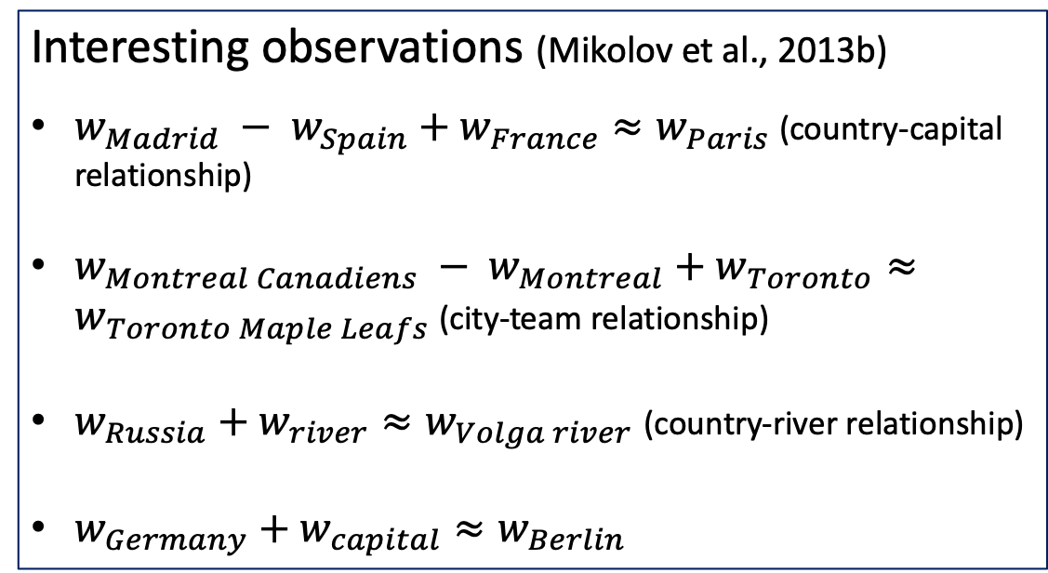
Word embeddings: Representing words as (dense) vectors
0.1896
-0.1002
-1.9648
0.1246
1.5183
1.7752
-0.4021
0.6291
0.1940
Interesting observations (Mikolov et al., 2013b)
$w_{Madrid} − w_{Spain}+w_{France}≈w_{Paris}$ (country-capital relationship)
$w_{Montreal Canadiens} − w_{Montreal}+w_{Toronto}≈w_{Toronto Maple Leafs}$ (city-team relationship)
$w_{Russia}+w_{river}≈w_{Volga river}$ (country-river relationship)
$w_{Germany}+w_{capital}≈w_{Berlin}$
$w_{banking}$ =
Popular embeddings:
Word2Vec (Mikolov et al., 2013a)
GloVe (Pennington et al., 2014)
FastText (Bojanowski et al., 2017)

Slide 11


Cross-lingual mapping problem
$$X$$
$$Z$$
king
पानी
eat
राजा
sun
खा
water
रवि
Aim: Learn a mapping function between the sets

Slide 12

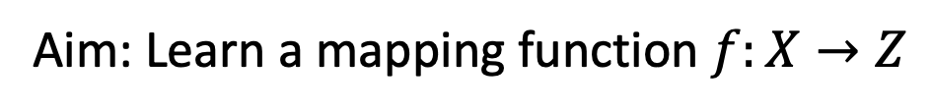

Mapping cross-lingual word embeddings
$$X$$
$$Z$$
king
पानी
eat
$$f$$
राजा
sun
खा
water
रवि
Aim: Learn a mapping function $f:X→Z$

Slide 13








Supervised cross-lingual mapping problem
$$X$$
$$Z$$
$$x_{1}$$
$$z_{1}$$
$$x_{2}$$
$$f$$
$$z_{2}$$
$$x_{3}$$
$$z_{3}$$
$$x_{4}$$
$$z_{4}$$
Training dictionary (supervision)
king | राजा
eat | खा
… | …
sun | रवि

Slide 14
Unsupervised cross-lingual mapping problem
$$X$$
$$Z$$
$$x_{1}$$
$$z_{1}$$
$$x_{2}$$
$$f$$
$$z_{2}$$
$$x_{3}$$
$$z_{3}$$
$$x_{4}$$
$$z_{4}$$
Training dictionary (supervision)

Slide 15
Supervised cross-lingual mapping

Slide 16
Is it possible to learn a good mapping?
Languages share concepts grounded in the real world
Some evidence of semantic relatedness between concepts across languages (Youn et al., 2016)
Assumption: the word embedding spaces of different languages are approximately isomorphic (Mikolov et al., 2013c; Barone, 2016)

Slide 17
Linear relationship between languages
Word vector representations of numbers in English (left) and Spanish (right). The five vectors in each language were projected down to two dimensions using PCA, and then manually rotated to accentuate their similarity.
The figure is from the work: Exploiting Similarities among Languages for Machine Translation (Mikolov et al., 2013c)

Slide 18
Linear relationship between languages
Word vector representations of animals in English (left) and Spanish (right). The five vectors in each language were projected down to two dimensions using PCA, and then manually rotated to accentuate their similarity.
The figure is from the work: Exploiting Similarities among Languages for Machine Translation (Mikolov et al., 2013c)

Slide 19







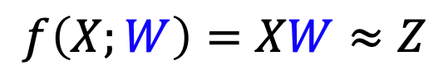



Linear model for cross-lingual mapping
$$f\left(X;W\right)=XW≈Z$$
$$X$$
$$Z$$
king
$$x_{1}$$
Row vectors of dimension $d$
$$z_{1}$$
राजा
eat
$$x_{2}$$
$$z_{2}$$
खा
Given dictionary between
the source and the target languages (training data)
sun
$$x_{3}$$
$$z_{3}$$
रवि
water
$$x_{4}$$
$$z_{4}$$
पानी

Slide 20
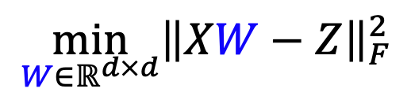

Linear model for cross-lingual mapping
Least squares problem:
$$\min_{W∈ℝ^{d×d}}{{\left\|XW−Z\right\|}_{F}^{2}}$$
(Mikolov et al., 2013c)
$$X$$
$$Z$$
king
$$x_{1}$$
Row vectors of dimension $d$
$$z_{1}$$
राजा
eat
$$x_{2}$$
$$z_{2}$$
खा
Given dictionary between
the source and the target languages (training data)
sun
$$x_{3}$$
$$z_{3}$$
रवि
water
$$x_{4}$$
$$z_{4}$$
पानी

Slide 21
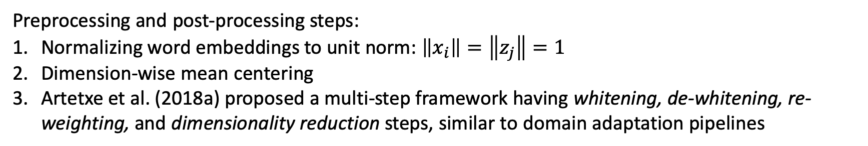
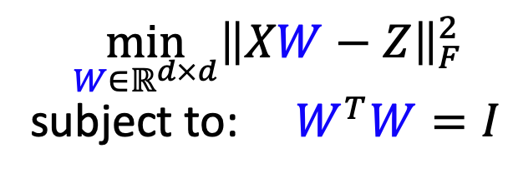
Preserving self consistency and monolingual quality of transformed embeddings
Orthogonal Procrustes
problem:
$$\min_{W∈ℝ^{d×d}}{{\left\|XW−Z\right\|}_{F}^{2}}$$
subject to: $W^{T}W=I$
(Xing et al., 2015;
Artetxe et al., 2016, 2018a;
Smith et al., 2017)
$W^{∗}=VU^{T}$, where $Z^{T}X=UΣV^{T}$ is the SVD factorization of $Z^{T}X$
Preprocessing and post-processing steps:
Normalizing word embeddings to unit norm: $\left\|x_{i}\right\|=\left\|z_{j}\right\|=1$
Dimension-wise mean centering
Artetxe et al. (2018a) proposed a multi-step framework having whitening, de-whitening, re-weighting, and dimensionality reduction steps, similar to domain adaptation pipelines

Slide 22




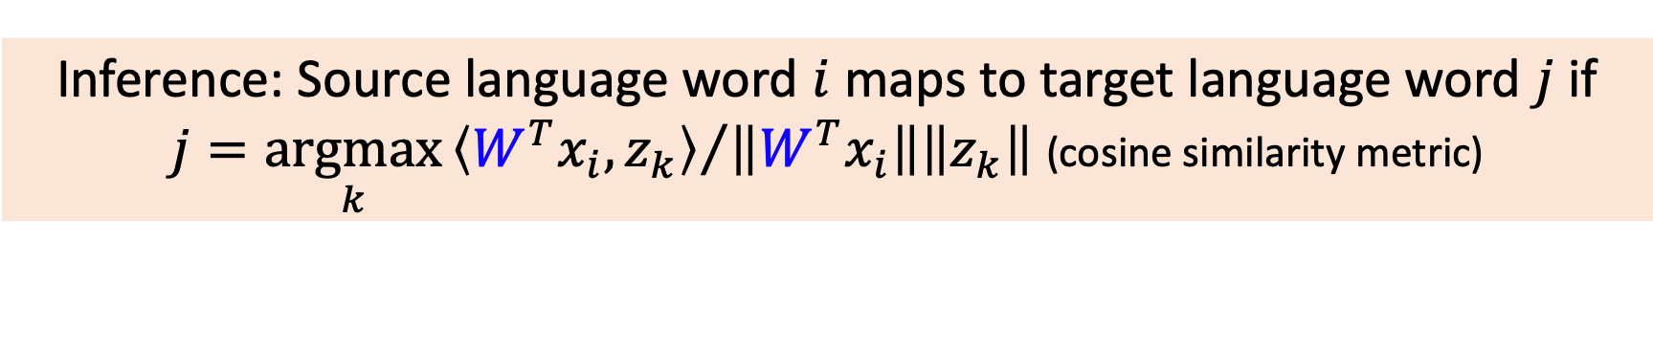






Inference: Nearest neighbor (NN) search
$$z_{7}$$
Aligning word embeddings in the
target language space
rotation
$$W$$
$$W^{T}x$$
$$z_{6}$$
$$z_{3}$$
$$x$$
$$z_{4}$$
$$z_{5}$$
$$z_{1}$$
Nearest neighbor search via cosine similarity metric
water
पानी
$$z_{2}$$
Inference: Source language word $i$ maps to target language word $j$ if
$j=\underset{k}{argmax}{{\left\langle {W^{T}x}_{i},z_{k}\right\rangle }/{\left\|W^{T}x_{i}\right\|\left\|z_{k}\right\|}}$ (cosine similarity metric)

Slide 23
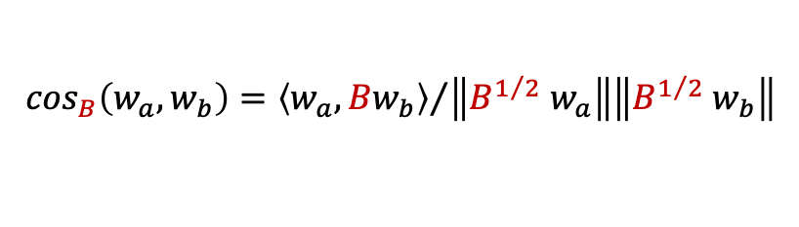

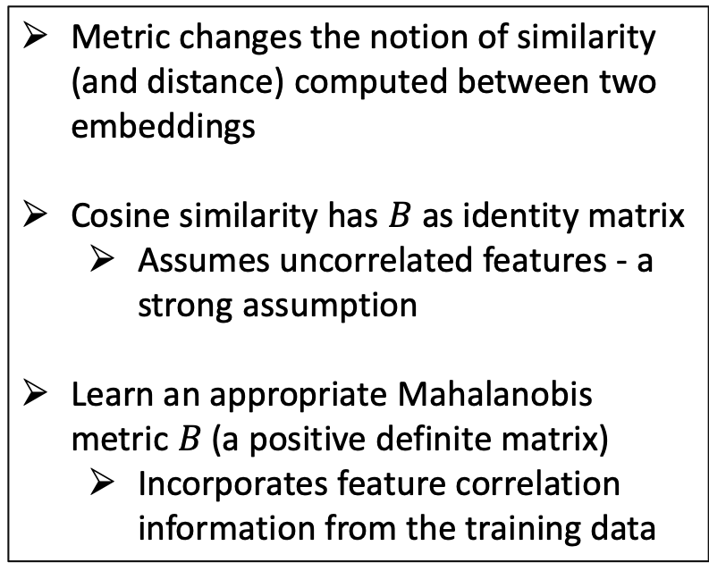

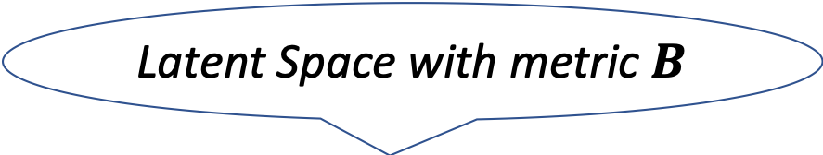





Mapping both the source and target language word embeddings to a latent space (J. et al., 2019)
Latent Space with metric $B$
Metric changes the notion of similarity (and distance) computed between two embeddings
Cosine similarity has $B$ as identity matrix
Assumes uncorrelated features - a strong assumption
Learn an appropriate Mahalanobis metric $B$ (a positive definite matrix)
Incorporates feature correlation information from the training data
$$\cos_{B}\left(w_{a},w_{b}\right)={\left\langle w_{a},{Bw}_{b}\right\rangle }/{\left\|{B^{1/2} w}_{a}\right\|\left\|{B^{1/2} w}_{b}\right\|}$$
$$U_{1}^{T}x$$
$$U_{2}^{T}z$$
$${(w}_{a})$$
$${(w}_{b})$$
$$U_{1}$$
$$U_{2}$$
(rotation)
(rotation)
$$x$$
$$z$$
water
पानी

Slide 24
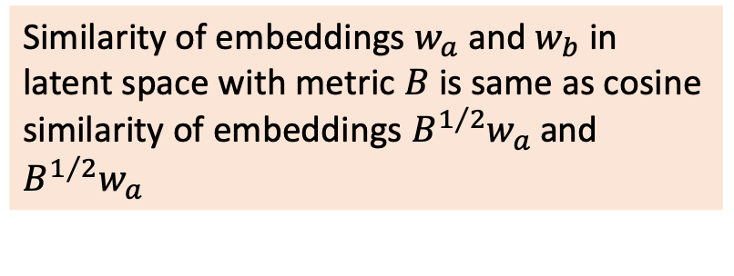
Latent space interpretation of the proposed model (J. et al., 2019)
Latent Space with metric $B$
Similarity of embeddings $w_{a}$ and $w_{b}$ in latent space with metric $B$ is same as cosine similarity of embeddings ${B^{1/2}w}_{a}$ and ${B^{1/2}w}_{a}$
$$U_{1}^{T}x$$
$$U_{2}^{T}z$$
$${(w}_{a})$$
$${(w}_{b})$$
$$U_{1}$$
$$U_{2}$$
(rotation)
(rotation)
$$x$$
$$z$$
water
पानी

Slide 25
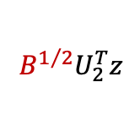
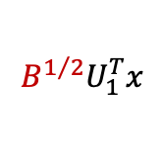
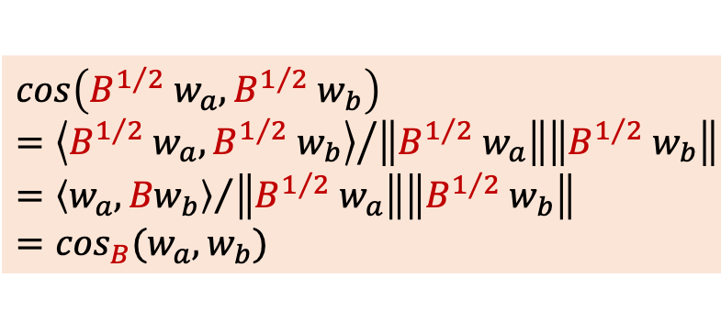
Latent space interpretation of the proposed model (J. et al., 2019)
Latent Space with metric $B$
Similarity of embeddings $w_{a}$ and $w_{b}$ in latent space with metric $B$ is same as cosine similarity of embeddings ${B^{1/2}w}_{a}$ and ${B^{1/2}w}_{a}$
$${B^{1/2}U}_{1}^{T}x$$
$${B^{1/2}U}_{2}^{T}z$$
$$U_{1}^{T}x$$
$$U_{2}^{T}z$$
$${(w}_{a})$$
$${(w}_{b})$$
$$cos\left({B^{1/2} w}_{a},{B^{1/2} w}_{b}\right)={\left\langle {B^{1/2} w}_{a},{B^{1/2} w}_{b}\right\rangle }/{\left\|{B^{1/2} w}_{a}\right\|\left\|{B^{1/2} w}_{b}\right\|}={\left\langle w_{a},{Bw}_{b}\right\rangle }/{\left\|{B^{1/2} w}_{a}\right\|\left\|{B^{1/2} w}_{b}\right\|} \\ =\cos_{B}(w_{a},w_{b})$$
$$U_{1}$$
$$U_{2}$$
(rotation)
(rotation)
$$x$$
$$z$$
water
पानी

Slide 26
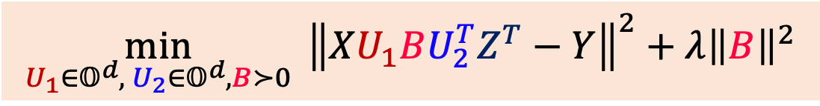
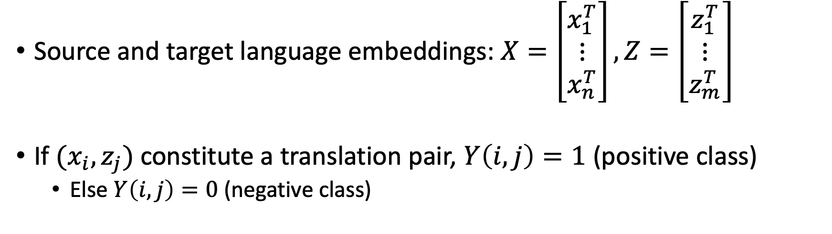
Cross-lingual mapping as a classification problem (J. et al., 2019)
Source and target language embeddings: $X=\left[\begin{matrix}x_{1}^{T} \\ ⋮ \\ x_{n}^{T}\end{matrix}\right],Z=\left[\begin{matrix}z_{1}^{T} \\ ⋮ \\ z_{m}^{T}\end{matrix}\right]$
If $(x_{i},z_{j})$ constitute a translation pair, $Y\left(i,j\right)=1$ (positive class)
Else $Y\left(i,j\right)=0$ (negative class)
$$\min_{U_{1}∈𝕆^{d},{ U}_{2}∈𝕆^{d}, B≻0}{ {\left\|XU_{1}BU_{2}^{T}Z^{T}−Y\right\|}^{2}}+λ{\left\|B\right\|}^{2}$$
Geometry-aware Multilingual Mapping (GeoMM)

Slide 27
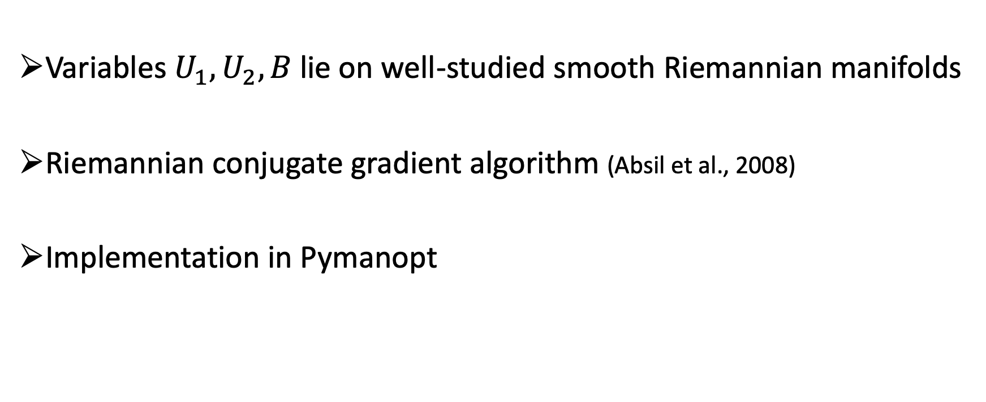
Optimization algorithm for GeoMM
Variables $U_{1}, U_{2}, B$ lie on well-studied smooth Riemannian manifolds
Riemannian conjugate gradient algorithm (Absil et al., 2008)
Implementation in Pymanopt

Slide 28
Generalizing GeoMM to Multilingual Setting
Bengali
French
Hindi
English
Tamil
Russian
German
An edge implies a training dictionary is available between the corresponding pair of languages

Slide 29



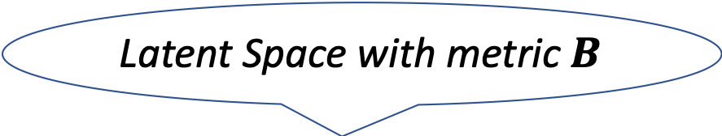

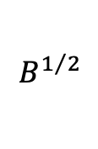

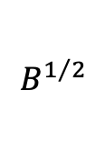

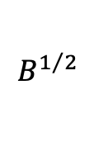
Latent space in GeoMM_{multi}
Latent Space with metric $B$
$$B^{1/2}$$
$$B^{1/2}$$
$$B^{1/2}$$
$$U_{1}$$
$$U_{2}$$
$$U_{3}$$
$$x$$
$$z$$
$$w$$
water
पानी
wasser

Slide 30
Unsupervised cross-lingual mapping

Slide 31



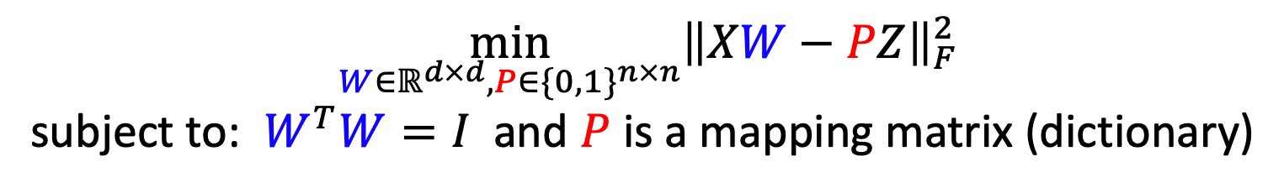




Unsupervised Orthogonal Procrustes
$$X$$
$$Z$$
$$x_{1}$$
$$z_{1}$$
$$.$$
.
.
$$.$$
.
.
$$x_{n}$$
$$z_{n}$$
$$\min_{W∈ℝ^{d×d}, P∈\{0,1\}^{n×n}}{{\left\|XW−PZ\right\|}_{F}^{2}}$$
subject to: $W^{T}W=I$ and $P$ is a mapping matrix (dictionary)

Slide 32
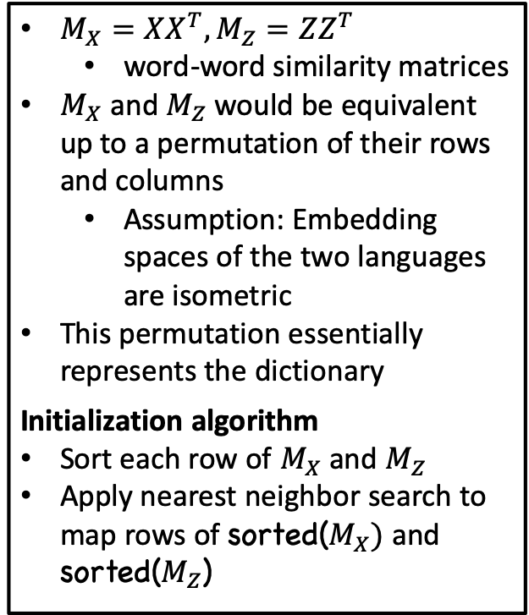
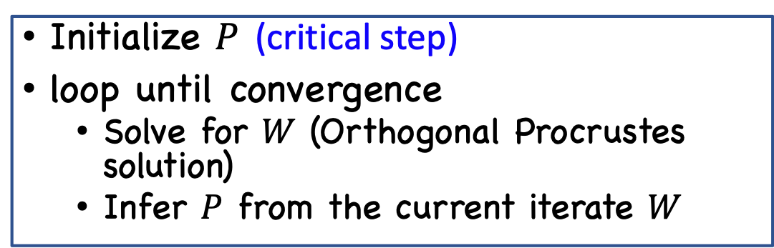
Self-learning algorithm (Artetxe et al., 2018b)
Initialize $P$ (critical step)
loop until convergence
Solve for $W$ (Orthogonal Procrustes solution)
Infer $P$ from the current iterate $W$
$M_{X}=XX^{T},M_{Z}=ZZ^{T}$
word-word similarity matrices
$M_{X}$ and $M_{Z}$ would be equivalent up to a permutation of their rows and columns
Assumption: Embedding spaces of the two languages are isometric
This permutation essentially represents the dictionary
Initialization algorithm
Sort each row of $M_{X}$ and $M_{Z}$
Apply nearest neighbor search to map rows of sorted($M_{X})$ and sorted($M_{Z}$)
Stochastic dictionary induction
Frequency based vocabulary cut-off
Keep only k (=20,000) most frequent words in each language
Bidirectional dictionary induction

Slide 33
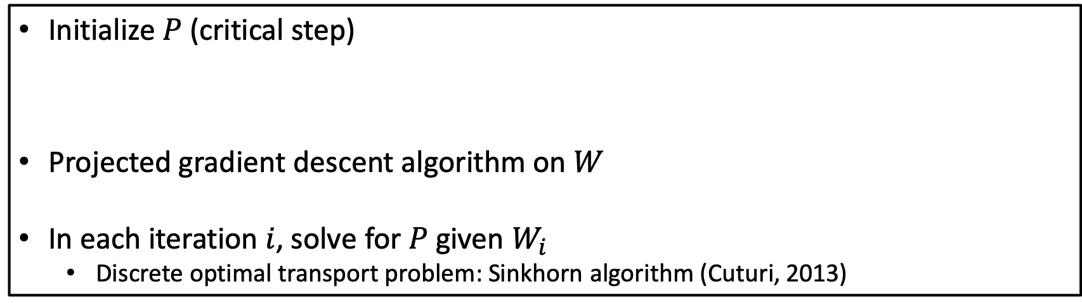
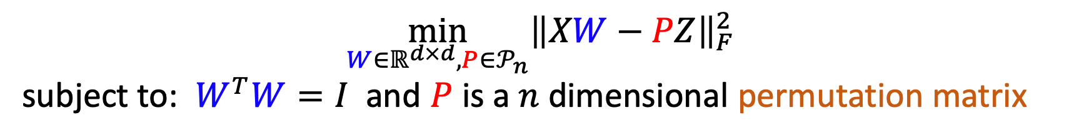
Wasserstein Procrustes (Grave et al., 2019)
$$\min_{W∈ℝ^{d×d}, P∈𝒫_{n}}{{\left\|XW−PZ\right\|}_{F}^{2}}$$
subject to: $W^{T}W=I$ and $P$ is a $n$ dimensional permutation matrix
Initialize $P$ (critical step)
Projected gradient descent algorithm on $W$
In each iteration $i$, solve for $P$ given $W_{i}$
Discrete optimal transport problem: Sinkhorn algorithm (Cuturi, 2013)
$\min_{P∈𝒫_{n}}{{\left\|P^{T}M_{X}P−M_{Z}\right\|}_{F}^{2}}$ : relax $P$ to bi-stochastic matrix and use Frank-Wolfe for minimization

Slide 34
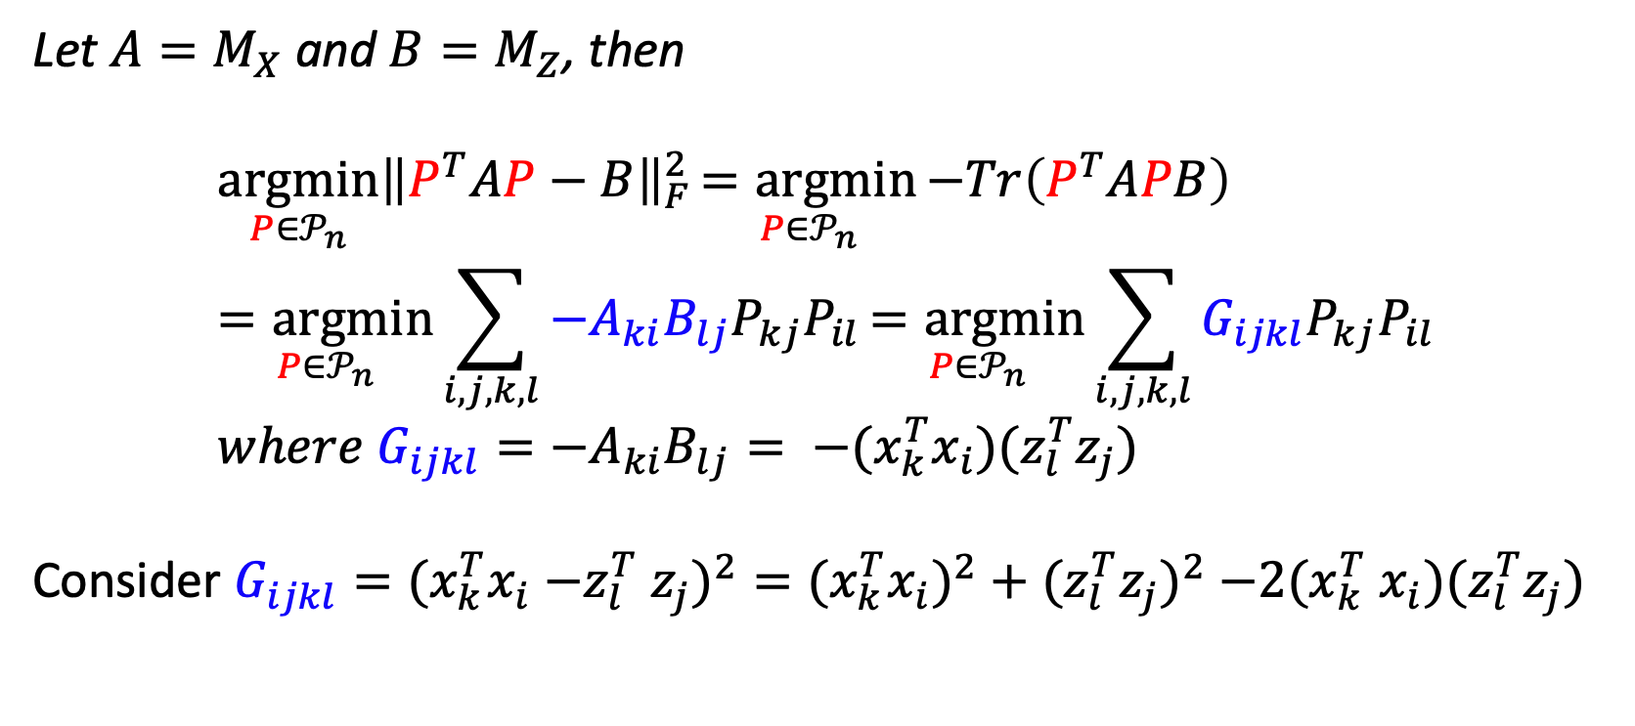
Gromov-Wasserstein alignment of word embedding spaces (Alvarez-Melis and Jaakkola, 2018)
Let ${A=M}_{X}$ and ${B=M}_{Z}$, then
$$\underset{P∈𝒫_{n}}{argmin}{{\left\|P^{T}AP−B\right\|}_{F}^{2}}\underset{P∈𝒫_{n}}{=argmin}{−Tr\left(P^{T}APB\right)} \\ \underset{P∈𝒫_{n}}{=argmin}{\sum_{i,j,k,l}{−A_{ki}B_{lj}P_{kj}P_{il}}}\underset{P∈𝒫_{n}}{=argmin}{\sum_{i,j,k,l}{G_{ijkl}P_{kj}P_{il}}} \\ where{ G}_{ijkl}=−A_{ki}B_{lj}= {−(x}_{k}^{T}x_{i}{)(z}_{l}^{T}z_{j})$$
Consider $G_{ijkl}=(x_{k}^{T}x_{i}{−z}_{l}^{T}z_{j})^{2}=(x_{k}^{T}x_{i})^{2}+(z_{l}^{T}z_{j})^{2}{−2(x}_{k}^{T}x_{i}{)(z}_{l}^{T}z_{j})$

Slide 35
More on Inference

Slide 36
Inference: How to produce more reliable matching than Nearest neighbor search?
Nearest neighbors are asymmetric
In high-dimensional spaces, this leads to hubness (Radovanovic ́ et al., 2010)
Few data points (hubs) become nearest neighbors of many other data points
While others (anti-hubs) are not nearest neighbors of any point

Slide 37
Inference: How to produce more reliable matching than Nearest neighbor search?
Nearest neighbors are asymmetric
In high-dimensional spaces, this leads to hubness (Radovanovic ́ et al., 2010)
Few data points (hubs) become nearest neighbors of many other data points
While others (anti-hubs) are not nearest neighbors of any point
Hubness is viewed as a direct result of the curse of dimensionality
It is linked to another aspect of the curse of dimensionality: distance concentration
All points in high dimensional space to be at almost the same distance to all other points
Observed in other applications areas such as vision and graphs

Slide 38
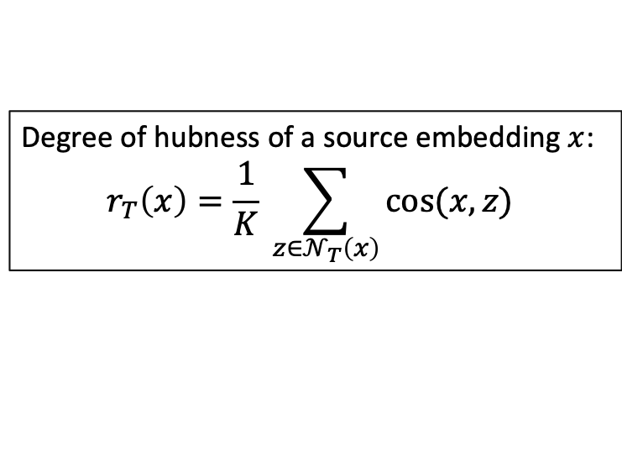

Cross-domain similarity local scaling (Conneau et al., 2018a; Joulin et al., 2018)
$𝒩_{T}\left(x\right):$ K nearest neighbors of the embedding $x$ in target language space
$𝒩_{S}\left(z\right):$ K nearest neighbors of the embedding $z$ in source language space
Typically, K is set to 10
Degree of hubness of a source embedding $x$:
$$r_{T}\left(x\right)=\frac{1}{K} \sum_{{z∈𝒩}_{T}\left(x\right)}{cos⁡(x,z)}$$
Degree of hubness of a target embedding $z$:
$$r_{S}\left(z\right)=\frac{1}{K} \sum_{{x∈𝒩}_{S}\left(z\right)}{cos⁡(x,z)}$$
$$CSLS\left(x,z\right)=2\cos\left(x,z\right)−r_{T}\left(x\right)−r_{S}\left(z\right)$$
Penalizing the hubness

Slide 39
Empirical results

Slide 40
Evaluation tasks
Bilingual lexicon induction (BLI)
Word translation task
Comparison metric is precision
Indirect translation: one-hop translation (BLI) task
Source and target languages share a bilingual dictionary only with a pivot language

Slide 41
Datasets
MUSE (Conneau et al., 2018)
Bilingual dictionaries from English to many languages such as Spanish (es), French (fr), German (de), Russian (ru), Chinese (zh), and vice versa
VecMap (Dinu and Baroni, 2015, Artetxe et al., 2017, 2018a)
Bilingual dictionaries from English (en) to four languages: Italian (it), German (de), Finnish (fi) and Spanish (es)
In both datasets, the training sets contain around 5000 − 6000 pairs while the test sets contain around 1500 pairs

Slide 42
Direct translation: BLI task, MUSE X-En dataset
Table: Precision@1 for BLI on the MUSE X-En dataset.
Performance of supervised methods is better than unsupervised methods, with GeoMM obtaining the best results
Unsupervised methods perform poorly on distant languages
Sometimes, the runs do not converge
GeoMM_{multi} is robust in incorporating languages from diverse families
Useful property for downstream multilingual applications
Method | es-en | fr-en | de-en | ru-en | zh-en | avg.
Supervised
GeoMM | 85.5 | 84.2 | 76.7 | 67.6 | 45.3 | 71.9
GeoMM_{multi} | 85.7 | 83.9 | 75.7 | 67.2 | 44.9 | 71.5
Procrustes | 82.9 | 82.4 | 72.4 | 63.7 | 36.7 | 67.6
Artetxe et al. (2018a) | 83.8 | 83.1 | 73.5 | 67.3 | 43.4 | 70.2
Unsupervised
Artetxe et al. (2018b) | 84.7 | 83.6 | 74.3 | 65.6 | 0.0 | 61.6
Conneau et al. (2018) | 83.3 | 82.1 | 72.2 | 59.1 | 31.4 | 65.6
Wasserstein Procrustes | 84.1 | 82.9 | 73.3 | 59.1 | - | n.a.
Gromov-Wasserstein | 80.4 | 78.9 | 72.8 | 43.7 | - | n.a.
Chen and Cardie (2018) | 83.7 | 81.8 | 72.9 | - | - | n.a.

Slide 43
Direct translation: BLI task, MUSE En-X dataset
Table: Precision@1 for BLI on the MUSE En-X dataset.
Performance of supervised methods is better than unsupervised methods, with GeoMM obtaining the best results
Unsupervised methods perform poorly on distant languages
Sometimes, the runs do not converge
GeoMM_{multi} is robust in incorporating languages from diverse families
Useful property for downstream multilingual applications
Method | en-es | en-fr | en-de | en-ru | en-zh | avg.
Supervised
GeoMM | 81.9 | 82.1 | 74.9 | 52.8 | 49.1 | 68.2
GeoMM_{multi} | 81.0 | 81.9 | 75.1 | 51.7 | 49.4 | 67.8
Procrustes | 81.4 | 81.1 | 73.5 | 51.7 | 42.7 | 66.1
Artetxe et al. (2018a) | 80.5 | 80.5 | 73.5 | 50.5 | 32.3 | 63.5
Unsupervised
Artetxe et al. (2018b) | 82.3 | 82.3 | 75.1 | 49.2 | 0.0 | 57.8
Conneau et al. (2018) | 81.7 | 82.3 | 74.0 | 44.0 | 32.5 | 62.9
Wasserstein Procrustes | 82.8 | 82.6 | 75.4 | 43.7 | - | n.a.
Gromov-Wasserstein | 81.7 | 81.3 | 71.9 | 45.1 | - | n.a.
Chen and Cardie (2018) | 82.5 | 82.4 | 74.8 | - | - | n.a.

Slide 44
Direct translation: BLI task, VecMap dataset
Table: Precision@1 for BLI on the VecMap En-X dataset.
Method | en-it | en-de | en-fi | en-es | avg.
Supervised
GeoMM | 48.3 | 49.3 | 36.1 | 39.3 | 43.3
GeoMM_{multi} | 48.7 | 49.1 | 36.0 | 39.0 | 43.2
Procrustes | 44.9 | 46.5 | 33.5 | 35.1 | 40.0
Artetxe et al. (2018a) | 47.7 | 47.5 | 35.4 | 38.7 | 42.3
Doval et al. (2018) | 48.4 | 47.7 | 34.7 | 38.9 | 42.4
Kementchedjhieva et al. (2018) | 45.3 | 48.5 | 31.4 | - | n.a.
Unsupervised
Artetxe et al. (2018b) | 48.1 | 48.2 | 32.6 | 37.3 | 41.6
Conneau et al. (2018) | 45.2 | 46.8 | 0.4 | 35.4 | 31.9
Gromov-Wasserstein | 44.4 | 37.8 | 6.8 | 12.5 | 25.4

Slide 45









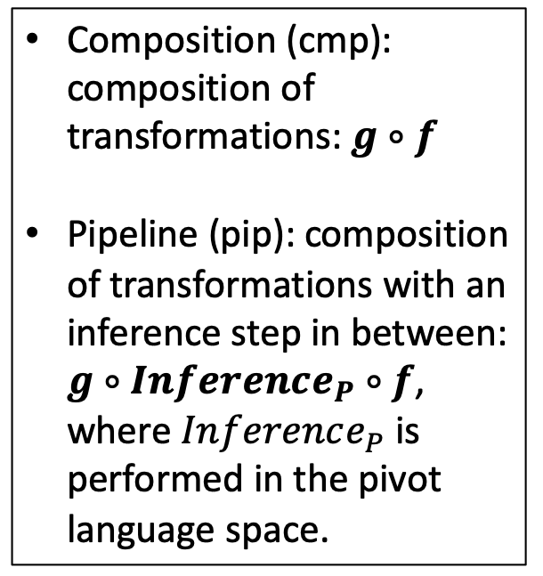








Indirect translation: Baselines
$$X$$
$$P$$
$$Z$$
Composition (cmp): composition of transformations: $g∘f$
Pipeline (pip): composition of transformations with an inference step in between: $g∘Inference_{P}∘f$, where $Inference_{P}$ is performed in the pivot language space.
$$x_{1}$$
Dictionary
available
$$p_{1}$$
Dictionary
available
$$z_{1}$$
$$x_{2}$$
$$p_{2}$$
$$z_{2}$$
$$x_{3}$$
$$p_{3}$$
$$z_{3}$$
$$f$$
$$g$$
$$x_{4}$$
$$p_{4}$$
$$z_{4}$$
$$h$$

Slide 46
Indirect translation: BLI task, MUSE dataset
Table: One-hop translation: Precision@1 for BLI.
Method | fr-it-pt | it-de-es | es-pt-fr | avg.
GeoMM_{multi} | 80.1 | 86.8 | 85.6 | 84.2
Composition
Procrustes | 74.2 | 81.9 | 82.5 | 79.5
Artetxe et al. (2018a) | 75.3 | 81.9 | 82.7 | 80.0
GeoMM | 77.7 | 84.1 | 84.3 | 82.0
Pipeline
Procrustes | 72.5 | 61.6 | 79.9 | 71.3
Artetxe et al. (2018a) | 75.9 | 64.5 | 82.5 | 74.3
GeoMM | 75.9 | 62.5 | 81.7 | 73.4
Unsupervised
Artetxe et al. (2018b) | 74.1 | 86.4 | 84.6 | 81.7
GeoMM_{multi} outperforms pivoting methods (composition and pipeline)
Pivoting methods may lead to cascading of errors in solution
Though unsupervised baseline performed better than pivoting methods, GeoMM_{multi} betters it as well

Slide 47
Summary
Cross-lingual mapping problem: lot of interest recently
Modelling the translation of embeddings from one language to another as a series of geometrical transformations is useful
Allows generalization to multilingual setting
Paper and code of GeoMM: https://pratikjawanpuria.com/
Supervised vs unsupervised methods on language pairs not from the same family: gap in performance
“On the Limitations of Unsupervised Bilingual Dictionary Induction” (Søgaard et al., 2018)
Can some easily available weak/distant supervision help?
Unsupervised methods based on the theory of optimal transport: interesting direction, results can improve

Slide 48
Learning cross-lingual mappings of word embeddings
Pratik Jawanpuria

